Slide 1
Discrete Math-Review

Slide 2
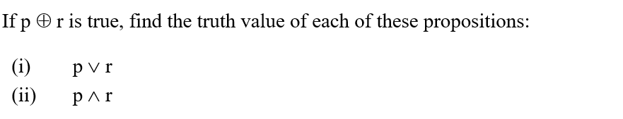
Chapter: Logic

Slide 3
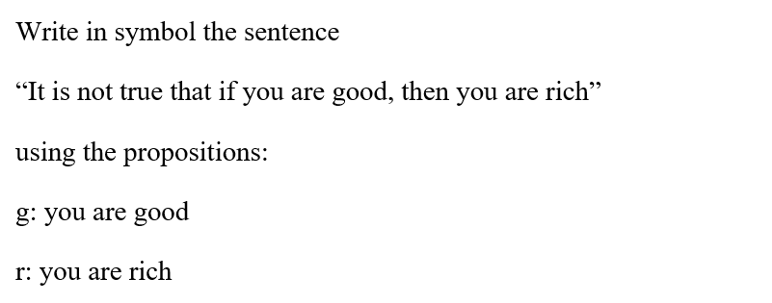
Chapter: Logic

Slide 4
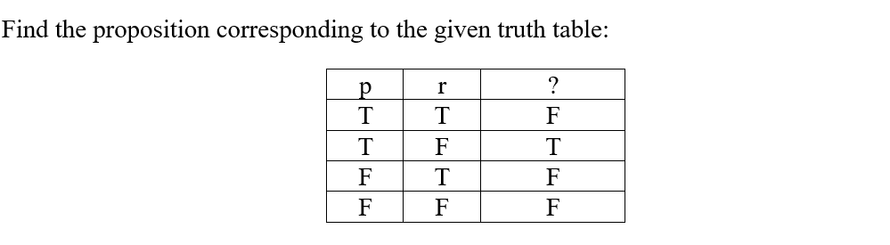
Chapter: Logic

Slide 5
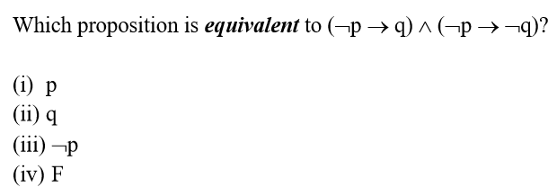
Chapter: Logic

Slide 6
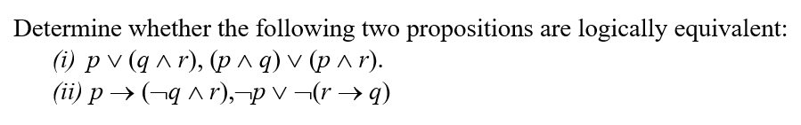
Chapter: Logic

Slide 7
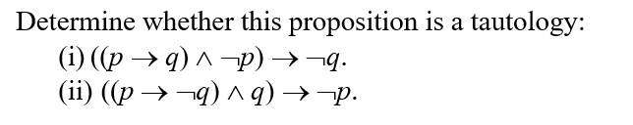
Chapter: Logic

Slide 8

Chapter: Logic

Slide 9

Chapter: Logic

Slide 10
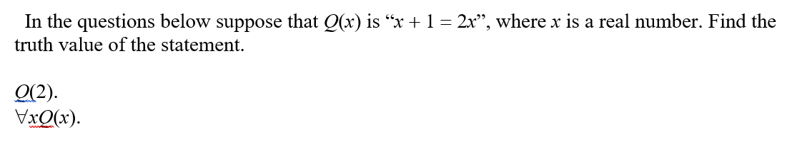
Chapter: Logic

Slide 11
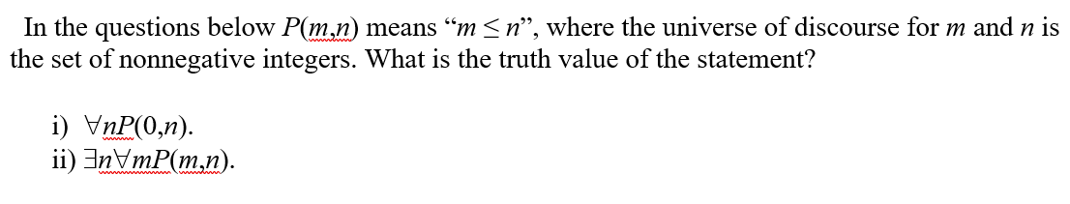
Chapter: Logic

Slide 12
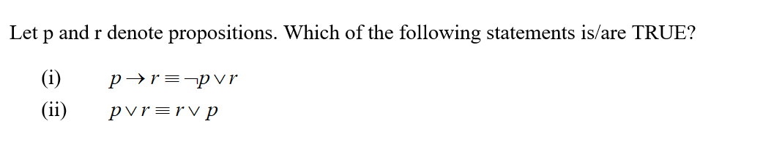
Chapter: Logic

Slide 13
Chapter: Logic

Slide 14
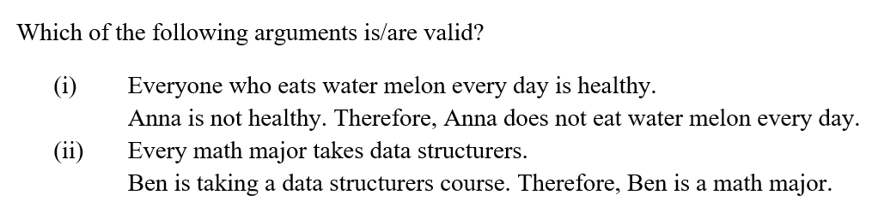
Chapter: Logic

Slide 15
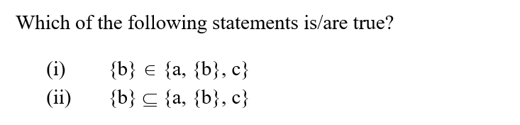
Chapter: sets – functions - sums

Slide 16
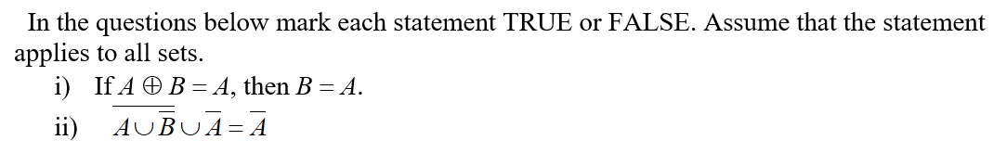
Chapter: sets – functions - sums

Slide 17
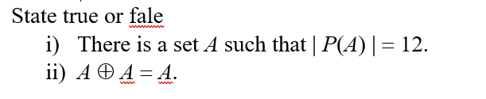
Chapter: sets – functions - sums

Slide 18
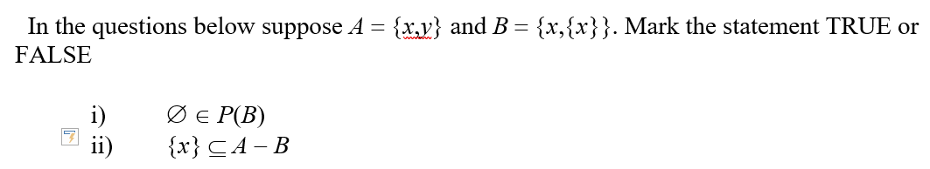
Chapter: sets – functions - sums

Slide 19
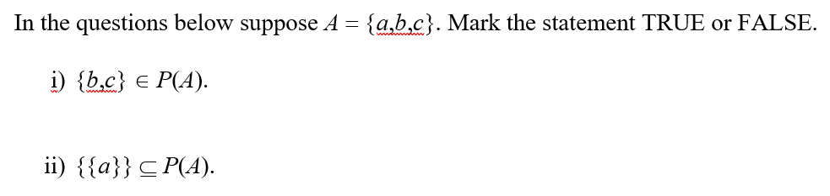
Chapter: sets – functions - sums

Slide 20
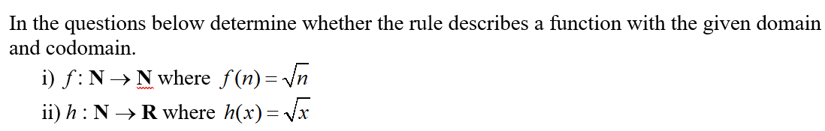
Chapter: sets – functions - sums

Slide 21
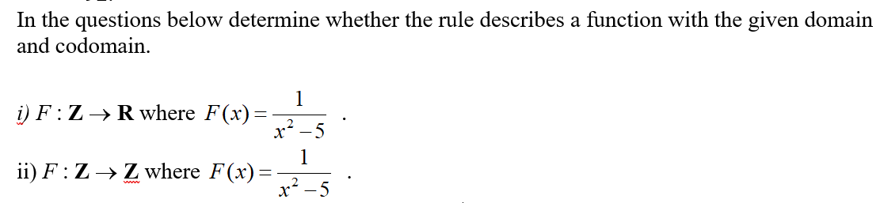
Chapter: sets – functions - sums

Slide 22
Chapter: sets – functions - sums

Slide 23
Chapter: sets – functions - sums

Slide 24
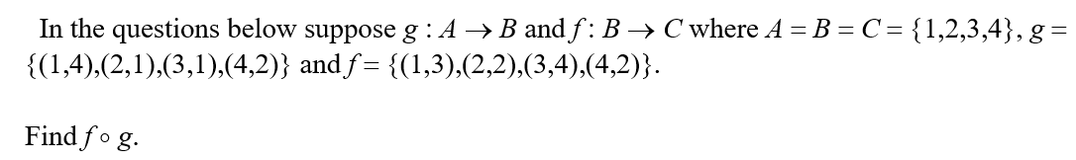
Chapter: sets – functions - sums

Slide 25

Chapter: sets – functions - sums

Slide 26
Chapter: sets – functions - sums

Slide 27
Chapter: sets – functions - sums

Slide 28
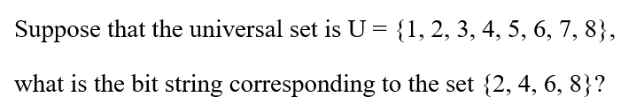
Chapter: sets – functions - sums

Slide 29

Chapter: sets – functions - sums

Slide 30
Chapter: sets – functions - sums

Slide 31
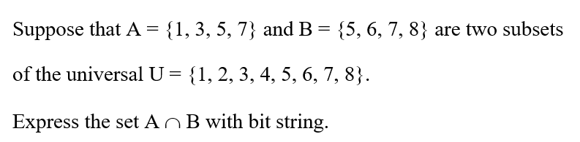
Chapter: sets – functions - sums

Slide 32
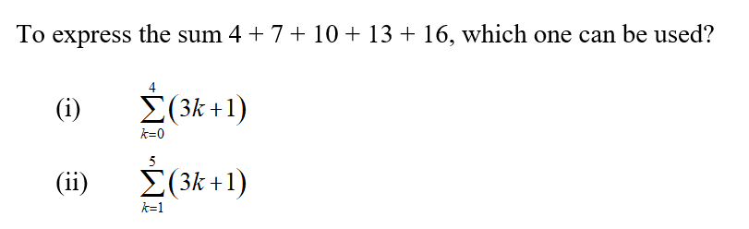
Chapter: sets – functions - sums

Slide 33
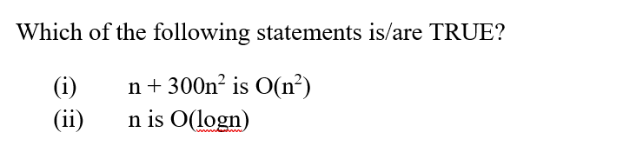
Chapter: algorithms – integers

Slide 34

Chapter: algorithms – integers

Slide 35
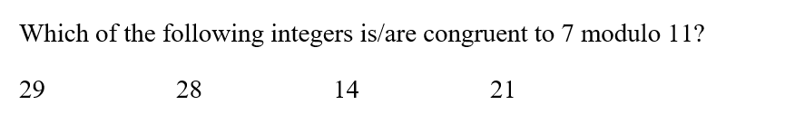
Chapter: algorithms – integers

Slide 36
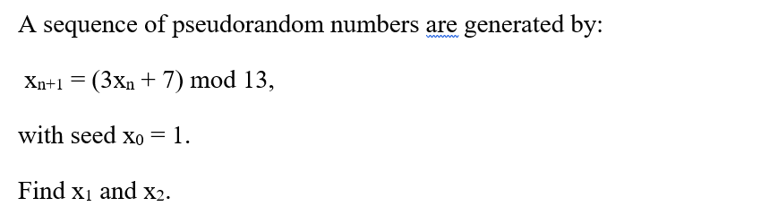
Chapter: algorithms – integers

Slide 37
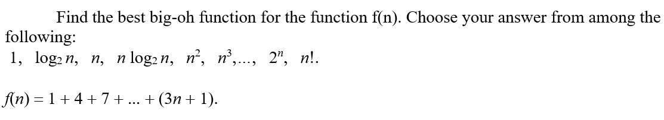
Chapter: algorithms – integers

Slide 38

Chapter: algorithms – integers

Slide 39
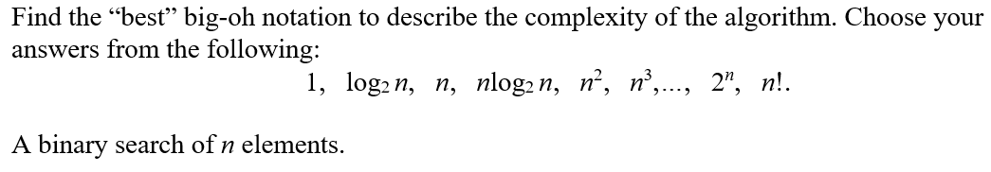
Chapter: algorithms – integers

Slide 40
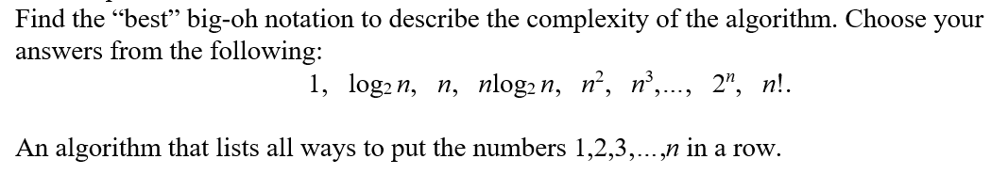
Chapter: algorithms – integers

Slide 41
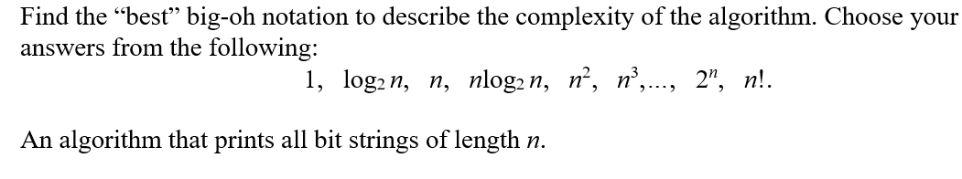
Chapter: algorithms – integers

Slide 42
Chapter: algorithms – integers

Slide 43
Chapter: algorithms – integers

Slide 44

Chapter: algorithms – integers

Slide 45
Chapter: algorithms – integers

Slide 46
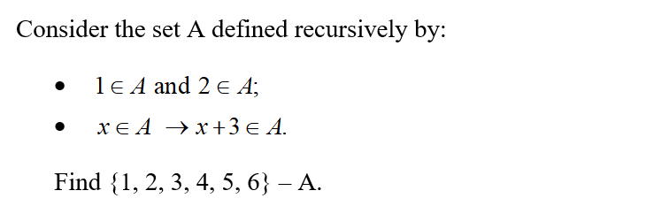
Chapter: algorithms – integers

Slide 47
Chapter: recursion - induction

Slide 48
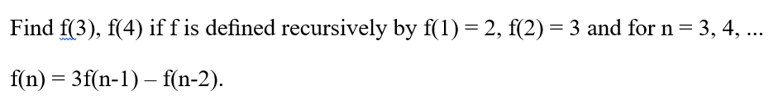
Chapter: recursion - induction

Slide 49
Consider the set A of bit strings deﬁned recursively by
1∈A
if w∈A, then w0∈A AND 1w∈A
Which of the following strings is in A?
0101
1010
Chapter: recursion - induction

Slide 50
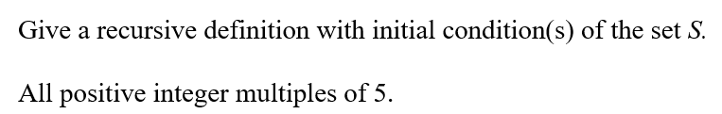
Chapter: recursion - induction

Slide 51
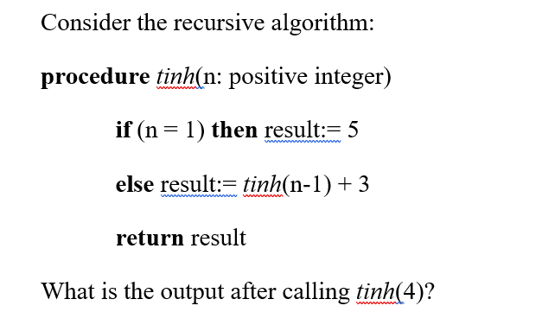
Chapter: recursion - induction

Slide 52
Chapter: counting

Slide 53
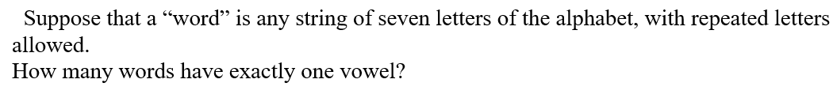
Chapter: counting

Slide 54
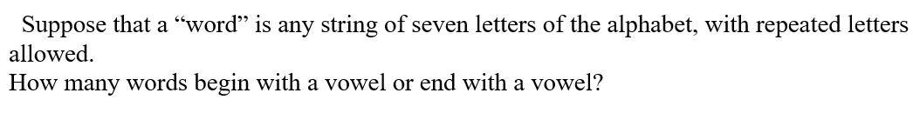
Chapter: counting

Slide 55
Chapter: counting

Slide 56
Chapter: counting

Slide 57
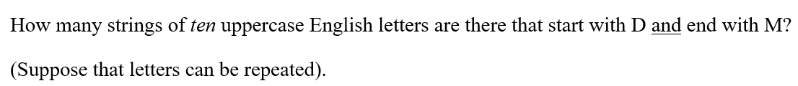
Chapter: counting

Slide 58
Chapter: counting

Slide 59
Chapter: counting

Slide 60
Chapter: graphs

Slide 61

Chapter: graphs

Slide 62

Chapter: graphs

Slide 63
Chapter: graphs

Slide 64
Chapter: graphs

Slide 65

Chapter: graphs

Slide 66
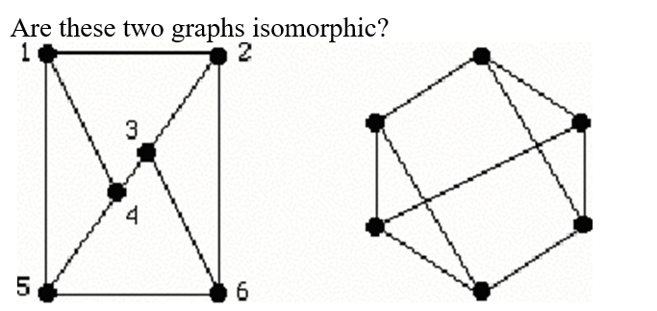
Chapter: graphs

Slide 67
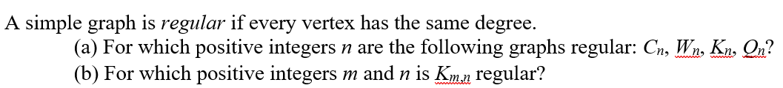
Chapter: graphs

Slide 68
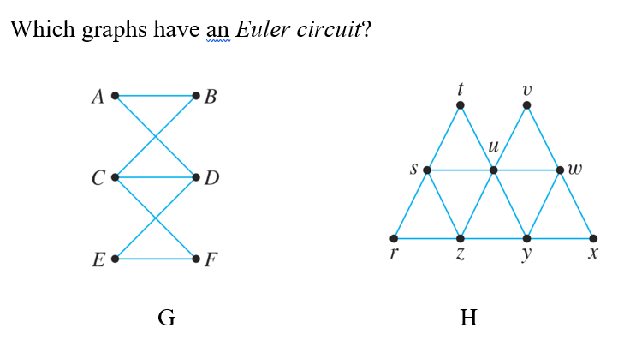
Chapter: graphs

Slide 69
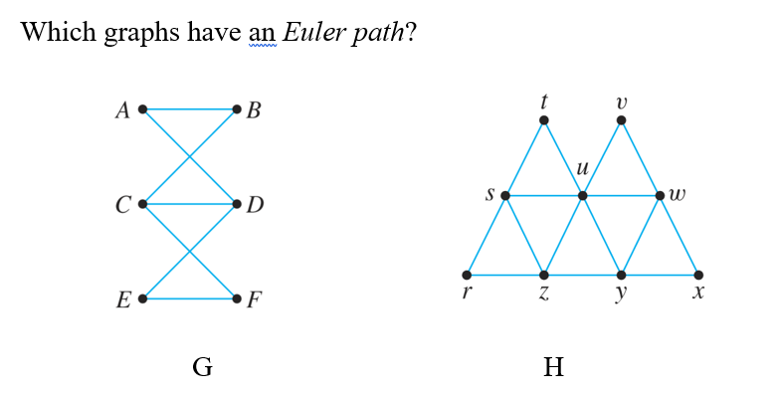
Chapter: graphs

Slide 70
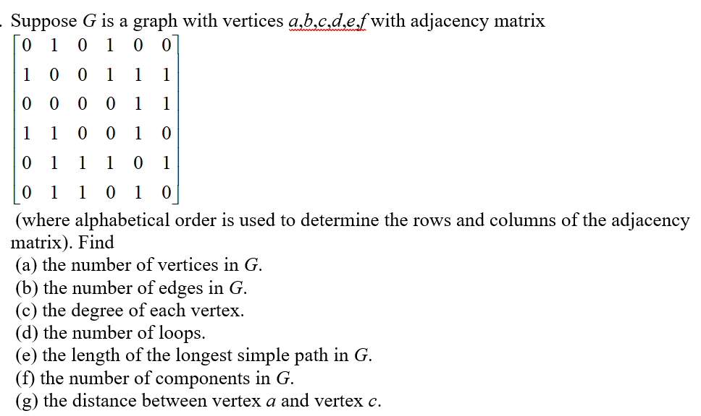
Chapter: graphs

Slide 71
Chapter: trees

Slide 72
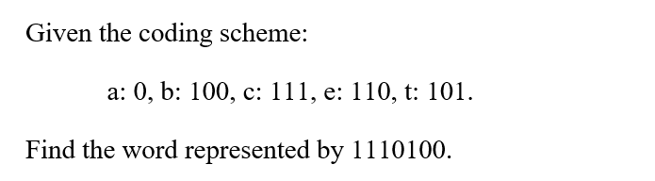
Chapter: trees

Slide 73
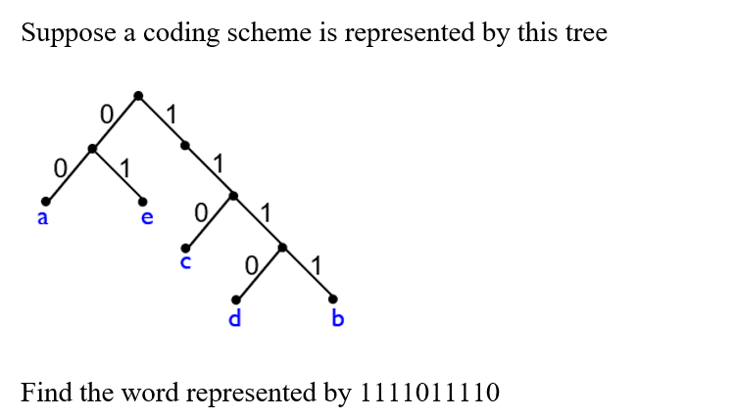
Chapter: trees

Slide 74

Chapter: trees

Slide 75
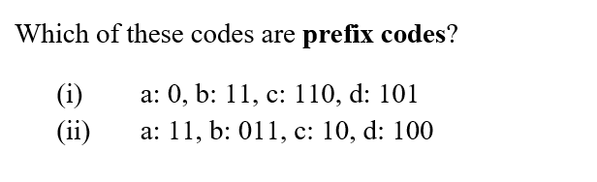
Chapter: trees

Slide 76
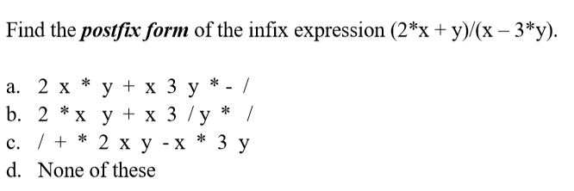
Chapter: trees

Slide 77
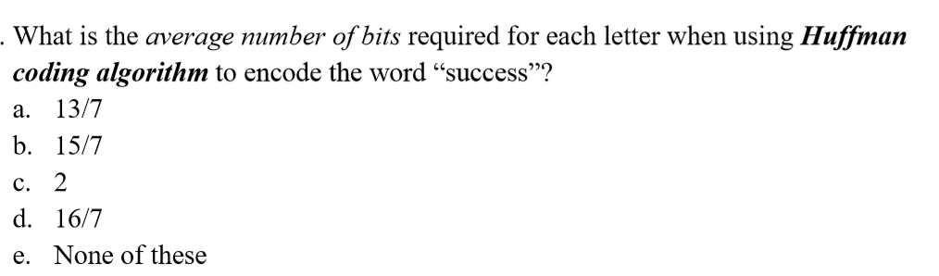
Chapter: trees

Slide 78
THANKS

